Slide 1


Team 30: OhmSweetHome
Bi-Weekly Update 4 Kim
Lawson
Caiden
Josh
Vivek TA: Roman Venegas
Notes:
Michelle

Slide 2
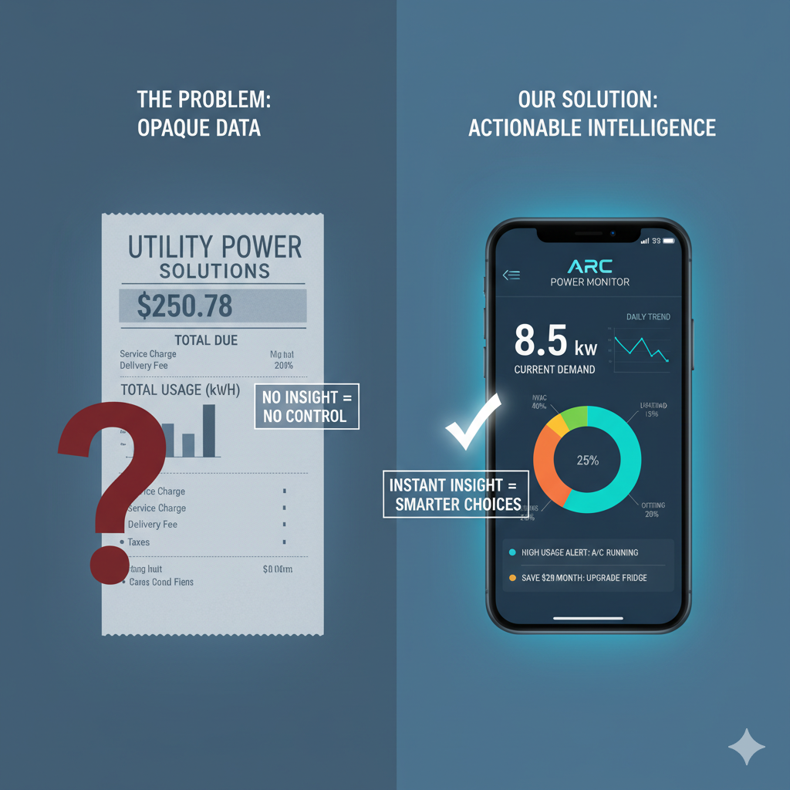
Project Summary
Problem:
Homeowners can only see their total electricity usage from utility meters, not what individual appliances are consuming.
Without device-level data, it's difficult for people to identify the main sources of energy waste and find effective ways to lower their utility bills.
Solution:
Analyzing the home's main power lines to identify the unique electrical signature of each active appliance in real-time.
Displaying a simple, device-by-device breakdown of energy consumption on a mobile app, empowering users to reduce waste and save money
Notes:
Kyle

Slide 3
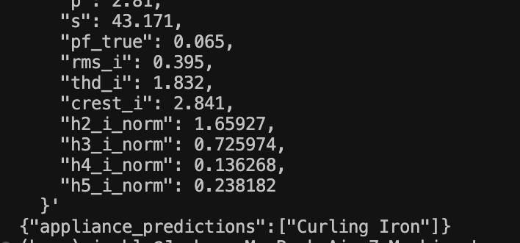
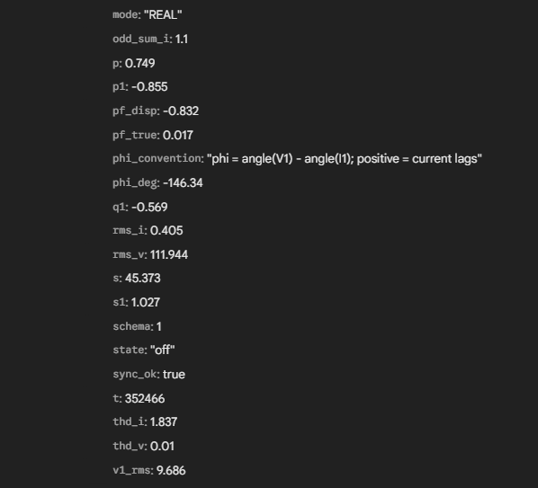
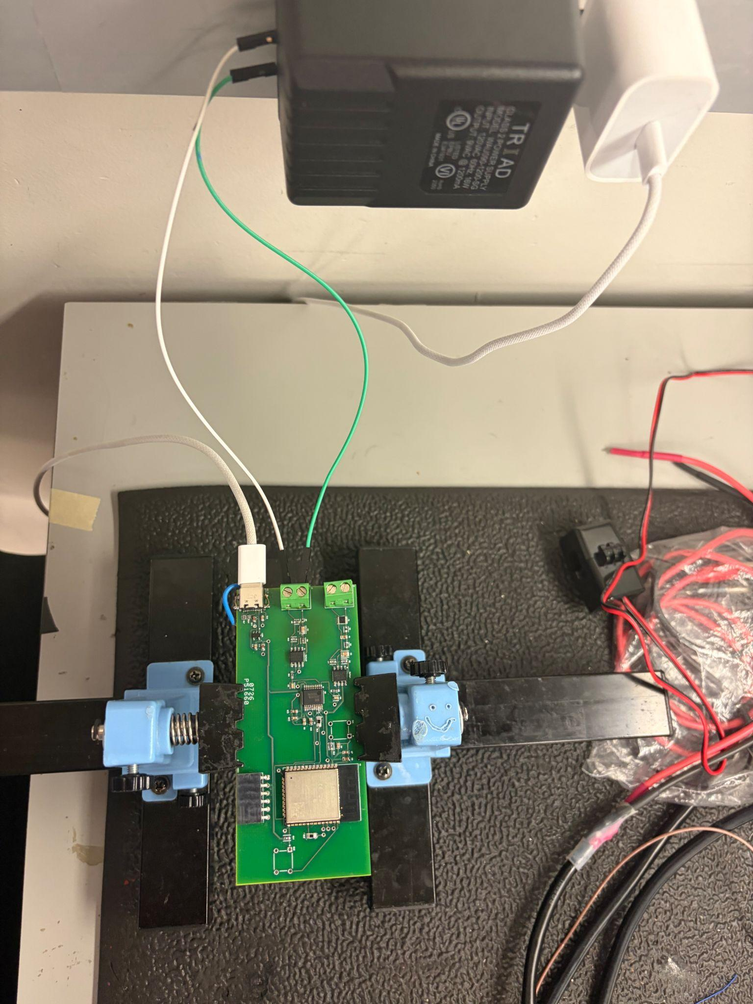
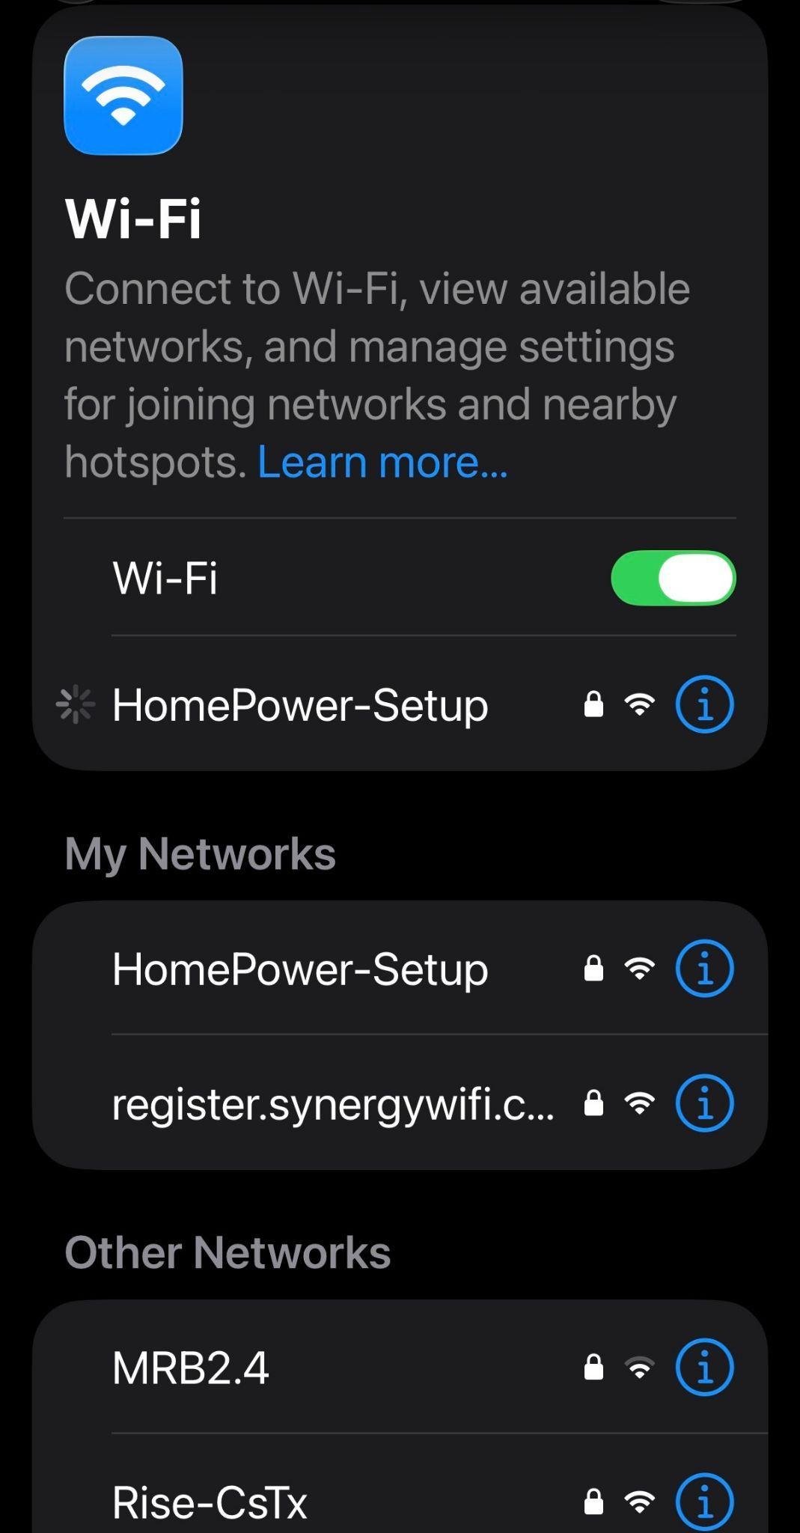
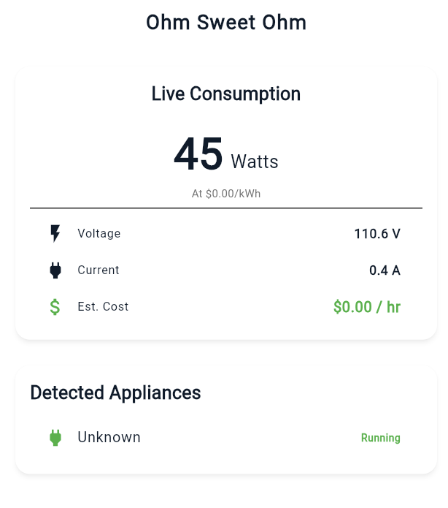
Integrated System Diagram
5V -> 3.3V Power Regulator
Voltage and Current Sensing Channels
Cloud response showing appliance prediction
App displaying live data from firebase frames
UART Programming Header
MCU: ESP32
Sample Frame of data from firebase after DSP pipeline
Notes:
Eric

Slide 4
Project Timeline
Subsystem Designs and Testing (completed 1/16) | Integration of Sensor Front End, Signal Conditioning (completed 1/23) | PCB integration of SFE, Signal Conditioning and Embedded Systems (completed 2/4) | Final Integration (to complete by 2/20) | System Test (to complete by 3/6) | Validation (to complete by 3/25) | Demo and Report (to complete by 4/15)
Notes:
Eric

Slide 5
Sensor Front End
Kim Peteros
Accomplishments since last update 24 hrs of effort | Ongoing progress/problems and plans until the next presentation
Completed PCB integration. Verified isolation between HV and logic. | Acquire more data from different appliances. Test using multiple appliances at one time through a power strip Ensure that it can run for at least 4 hours.

Slide 6
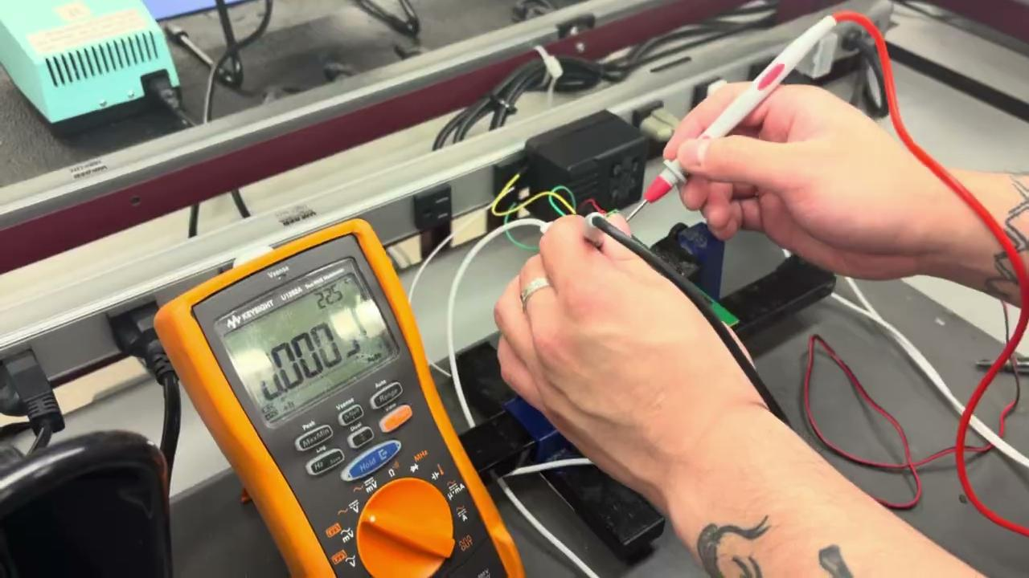
Sensor Front End
Kim Peteros

Slide 7
Signal Conditioning
Lawson Parr
Accomplishments since last update 20 hrs of effort | Ongoing progress/problems and plans until the next presentation
Verified that the PCB voltage and current channels are functioning correctly. Tested full subsystem integration using a curling iron and verified the PCB voltage and current channel outputs. | Test additional appliances, including a lamp, fan, and hair dryer. Verify detection of multiple appliances running simultaneously using a power strip. Ensure the fully integrated system can operate continuously and accurately for at least 4 hours.

Slide 8
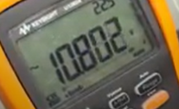
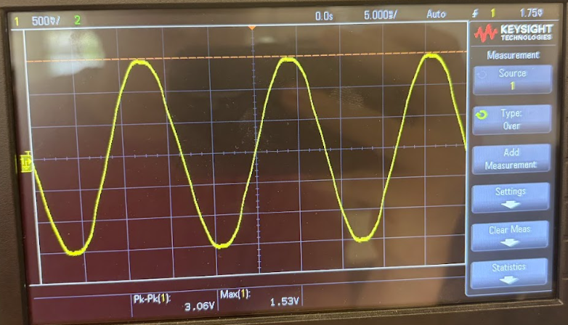
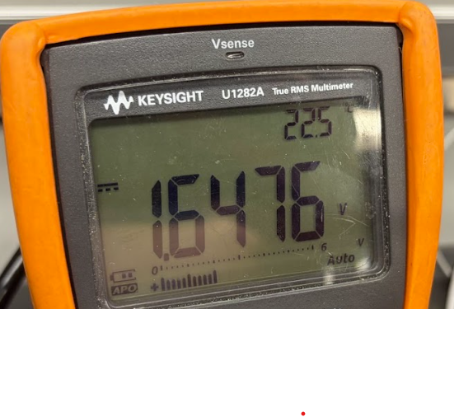
Signal Conditioning Lawson Parr
Voltage Sensing Channel (curling iron) :
Input AC Source
Conditioned Waveform
DC Bias Voltage

Slide 9
Embedded Systems Caiden Rueben
Accomplishments since last update 24 hrs of effort | Ongoing progress/problems and plans until the next presentation
Accomplishments since last review Powered custom PCB and verified 3.3 V rail, successfully programmed ESP32 firmware on hardware Validated 2 ADC channels (voltage & current) capturing 60 Hz AC waveforms Implemented DSP metrics: Vrms (~120 V), Irms, apparent power (~45 VA), and phase angle Generated structured JSON telemetry frames and verified Firebase uploads Ran 5–10 minute continuous tests generating hundreds of telemetry frames | Calibration Determine accurate voltage and current scale factors Validate measurements against known loads Power Measurements Accuracy Improve phase angle stability Refine real power calculation System Validation Run extended stability testing Verify measurement repeatability Demo Preparation Create visualizations of power data Finalize demonstration setup

Slide 10
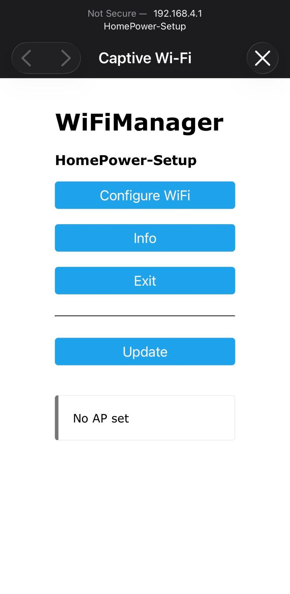
Embedded Systems Caiden Rueben
User connects to HomePower-Setup AP to configure network credentials.
Embedded DSP frame Vrms ≈120 V, Irms ≈0.4 A, S ≈45 VA from curling iron load test.

Slide 11
Machine Learning Joshua Le
Accomplishments since last update 20 hrs of effort | Ongoing progress/problems and plans until the next presentation
Retrained and redeployed the cloud inference API with the updated model then validated it through live API tests to confirm Cloud Run was serving the new prediction format correctly Collected and incorporated real appliance data into the training pipeline, including converting raw Firebase frame exports into the same feature format used for model training and adding Curling Iron as a new real-data class. | Continue collecting and incorporating real appliance data so the model can be evaluated on actual outlet-level electrical signatures instead of mostly simulated or legacy PLAID-derived data Refine model performance on in-scope appliances by retraining with the new real-data set and improving consistency Design and 3D print a protective housing for the PCB

Slide 12
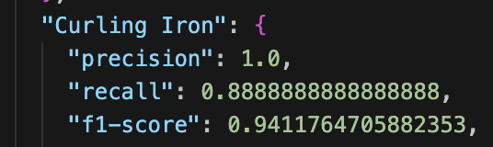
Machine Learning Joshua Le
The model correctly identified about 89% of the actual Curling Iron test samples, and when it predicted Curling Iron, it was correct 100% of the time.

Slide 13
Application Development
Vivek Samuel
Accomplishments since last update ~18 hrs of effort | Ongoing progress/problems and plans until the next presentation
Successfully completed the app's architectural migration to the live Firebase Realtime Database, enabling real-time parsing of MCU telemetry and nested Machine Learning predictions. Developed robust client-side data aggregation logic that automatically handles unsynced MCU timestamps and dynamically scales historical power usage charts based on the active load. | Problem/Progress: Discovered unexpected data variance in the Real Power sensor stream during live integration; successfully designed a hot-swappable data model in the app to pivot to Apparent Power (VA), ensuring a stable and reliable end-to-end demonstration today. Conduct full end-to-end system testing with a wider variety of physical appliance loads (e.g., resistive, inductive) to validate the ML identification accuracy and app UI under multi-load stress conditions.

Slide 14
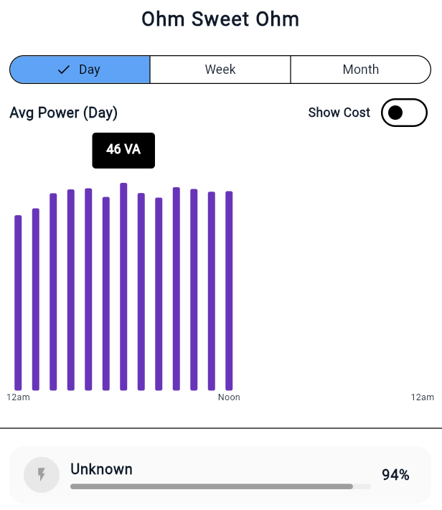
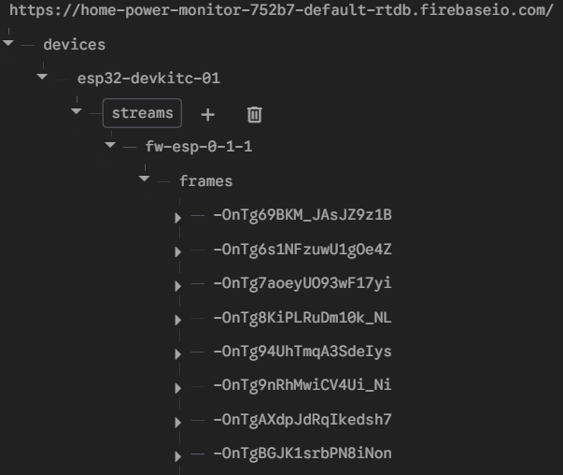
Application Development
Vivek Samuel

Slide 15
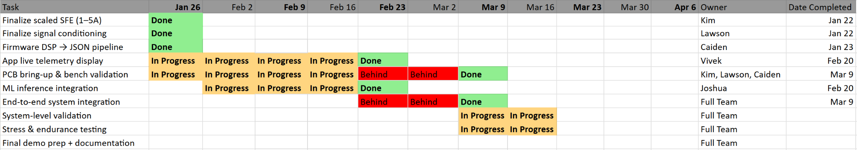
Execution Plan (45 sec)
Notes:
Michelle

Slide 16
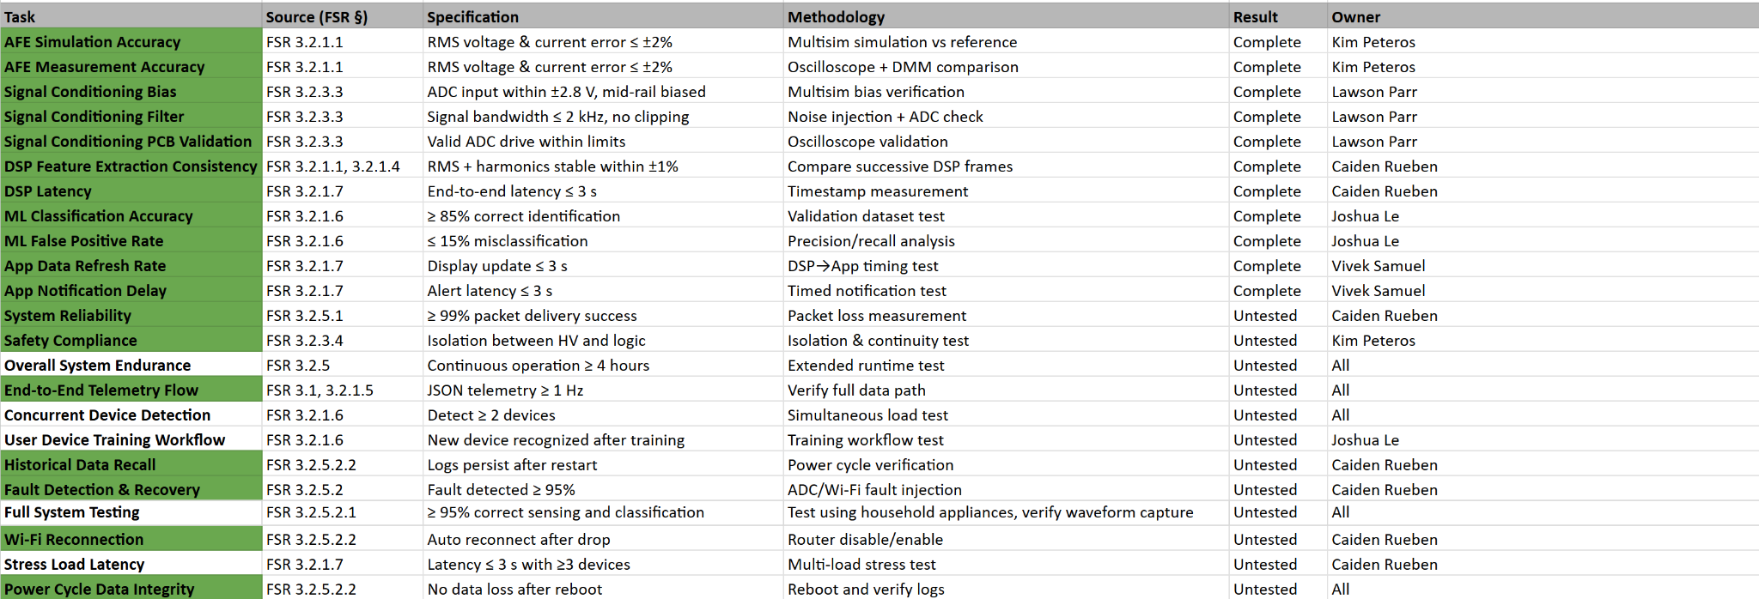
SYSTEM Validation Plan (1 minute)
Notes:
Michelle

Slide 17
Thank Y'all!

